Slide 1

Cost of family medical dental care in the past 12 months
https://www.cdc.gov/nchs/nhis/nhis_2017_data_release.htm
2017 NATIONAL HEALTH INTERVIEW SURVEY (NHIS) June 26, 2018
33,000 observation, 127 variable in family dataset

Slide 2
Cost of family medical/dental care in the past 12 months
Removing of variables with thousands of missing values
Removing of observations with missing values
Binning y variable to 1 high, over $500 per year, and 0 low
Creating dummy categorical variables
Checking for correlation between numerical variables only
Notes:
The dataset preprocessing steps depended on a particular statistical model requirements and included the following
-Recoding of missing values
-Removing of missing values
-Transforming variables
-Creating binary dummy variables for categorical variables
-Checking for correlations between numerical variables

Slide 3
Literature Review
Literature focused on healthcare approaches – natural medicine
Literature focused on areas of healthcare savings – preventive care (reducing arthritis)
Literature focused on healthcare costs causes - obesity
Black, L. I., Clarke, T. C., Barnes, P. M., Stussman, B. J., & Nahin, R. L. (2015). Use of complementary health approaches among children aged 4-17 years in the United States: National Health Interview Survey, 2007-2012. National health statistics reports, (78), 1-19.
Jean-Louis, G., Williams, N. J., Sarpong, D., Pandey, A., Youngstedt, S., Zizi, F., & Ogedegbe, G. (2014). Associations between inadequate sleep and obesity in the US adult population: analysis of the national health interview survey (1977-2009). BMC public health, 14, 290. doi:10.1186/1471-2458-14-290
Ma, V. Y., Chan, L., & Carruthers, K. J. (2014). Incidence, prevalence, costs, and impact on disability of common conditions requiring rehabilitation in the United States: stroke, spinal cord injury, traumatic brain injury, multiple sclerosis, osteoarthritis, rheumatoid arthritis, limb loss, and back pain. Archives of physical medicine and rehabilitation, 95(5), 986-995.e1.

Slide 4
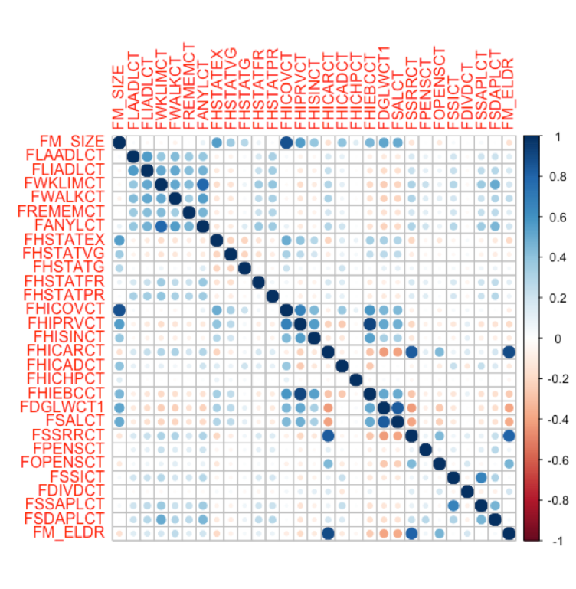

Method: Principal Components Analysis
Justification
Reduce the original 46 continuous variables to fewer components
Preparation
5 Variables with imbalance of missing data were removed
Correlation Analysis
12 variables with < .3 dropped
(Number Family Members in Good health)
Final Dataset = 29 variables

Slide 5
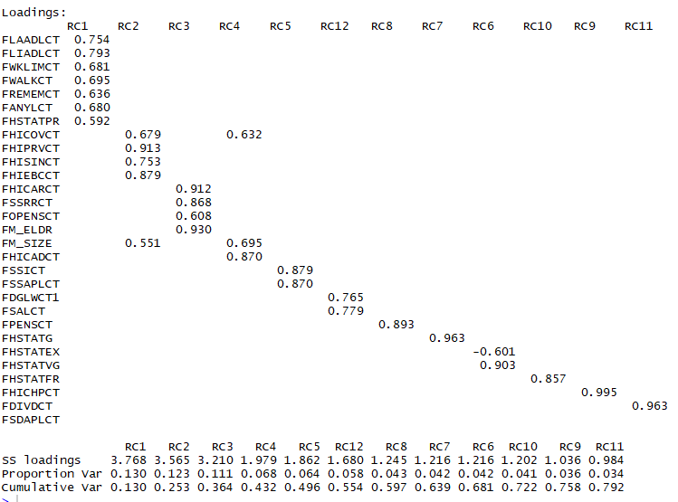
Results: Principal Components Analysis
12 Components Produced
.79 cumulative variance
5 components are 1 variable
Cross-loads removed by raising loading threshold to .5
Remaining cross loaded vars assigned by load size

Slide 6
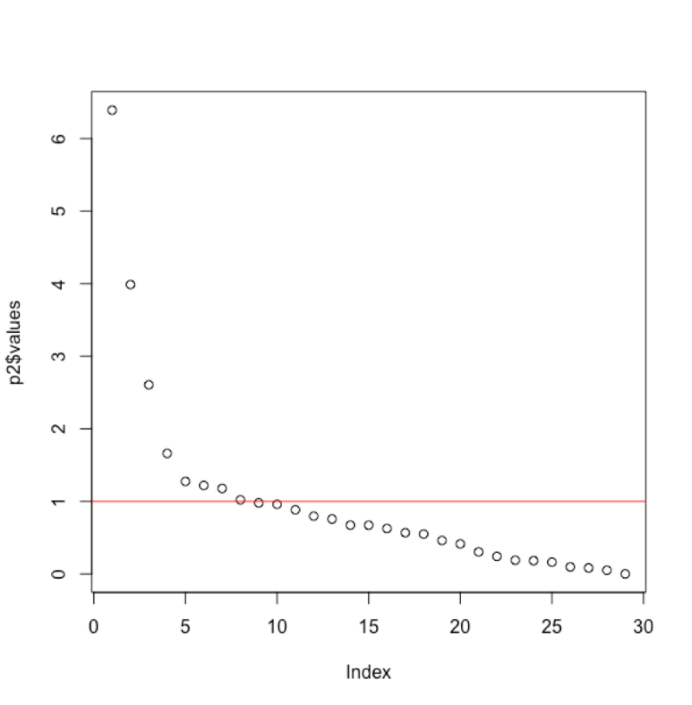
Results: Principal Components Analysis
Scree plot shows 8 components
Component RC1:
Health limitations, health conditions
Component RC2:
Type of health coverage

Slide 7
Common Factor Analysis
48 Variables with Numerical Values (with no missing values) with total observations was 33,000+
Scree plot recommended 8-10, "knee" test 3-5.
Common Factor Analysis done to see if variables can be reduced to factorability
Potential later CFA with Regression on Healthcare Cost for the Future
Notes:
Review of scree plot similar to the PCA, showed 8 based upon eigenvalues
Review of variables, reduced to 22 variables from 48 variables with numerical values, was only able to get 3 main factors with around 50% variance.

Slide 8
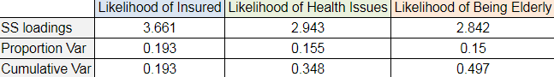
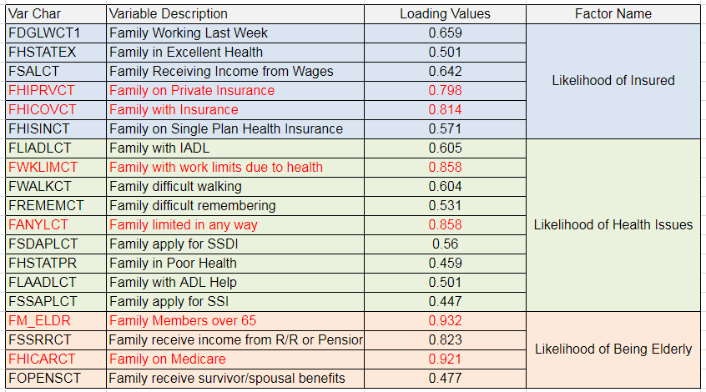
CFA Cont.
Reduced
to 19
Variables
3 Main
Factors
Notes:
Reviewed other 26 variables did not see much correlation

Slide 9
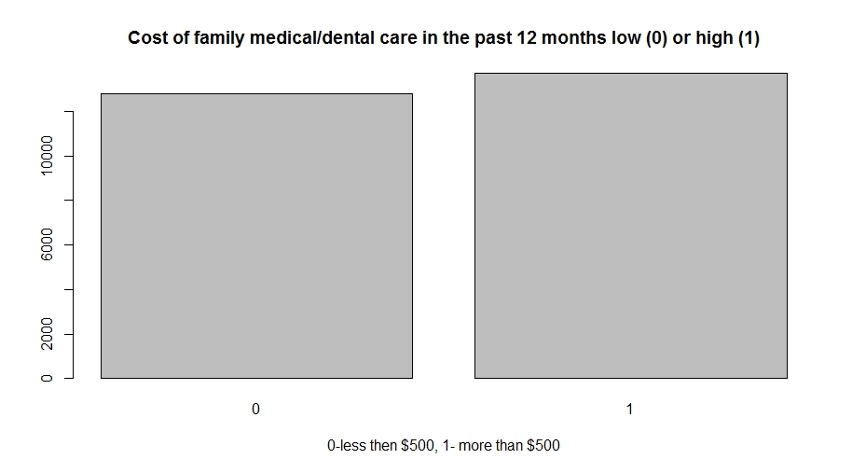
Cost of family medical/dental care in the past 12 months
Logistic Regression
Training / test data - 80/20
Automatic forward selection model – over 50 variables
Manual variable selection 20+ variables
Notes:
After data set was ready, I run logistic regression on training dataset , with split 80/20
I used automatic forward selection method based on Chi square values, which gave me very complicated model of over 50 variables,
So I decided to do manual selection based on p-values.
The final model was a little better, but it included over 20 variables

Slide 10
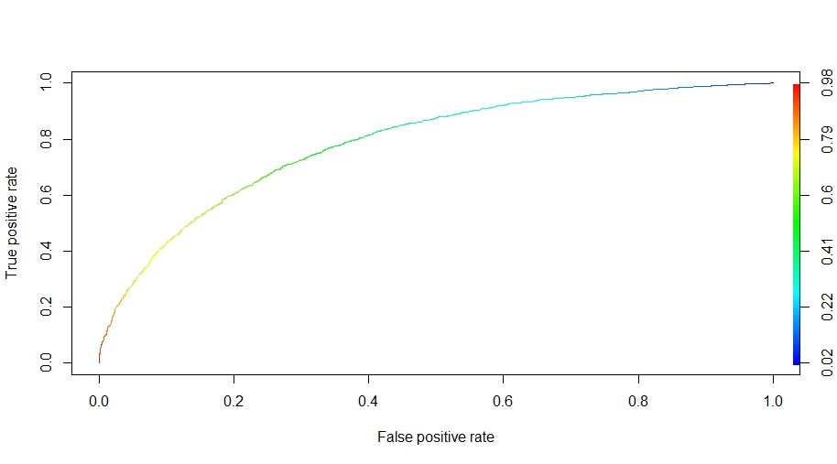
Cost of family medical/dental care in the past 12 months
Logistic Regression
Sensitivity = 0.748
Specificity = 0.676
Accuracy = 0.713
Precision = 0.712
Area Under Curve = 0.785
Notes:
For model validation on test dataset I used cut off value of 0.5.
Which gave me 0.71 accuracy, sensitivity, specificity and precision were also in that range.
The AUC are aunder curve which is the probability that the model will rank a randomly chosen positive example higher
than a randomly chosen negative example was of 0.78.

Slide 11
When a family is MORE likely to spend $500 or more for medical/dental expenses per year?
Logistic Regression
When total combined family income is more than $35,000 per year
When a family member received income from interest bearing account
When a family always was able to afford to eat balanced meal
When a family member did not receive food stamps
Higher the number of family members with private insurance
Married couples
When family includes parent, step parent and children
Notes:
The lesson learned was that family is MORE likely to spend $500 or more in medical/dental cost per year
When total combined family income is more than $35,000 per year
When a family member received income from interest bearing account
When a family always was able to afford to eat balanced meal
When a family member did not receive food stamps
Higher the number of family members with private insurance
Married couples
When family includes parent, step parent and children

Slide 12
When a family is LESS likely to spend $500 or more for medical/dental expenses per year?
Logistic Regression
When there is no working phone or cell phone in household
Lower the number of family member in Military or Medicaid
When a family rents house, apartment or is living with roommates
When a family member did not get medical advice or test in 2 weeks or stayed in hospital in 12 months,
When a family does not pay medical bills over the time
When family does not have flexible spending account
Notes:
So When a family is LESS likely to spend $500 or more in medical/dental cost per year?
When there is no working phone or cell phone in household
Lower the number of family member in Military or Medicaid
When a family rents house, apartment or is living with roommates
When a family member did not get medical advice or test in 2 weeks or stayed in hospital in 12 months,
When a family does not pay medical bills over the time
When family does not have flexible spending account

Slide 13
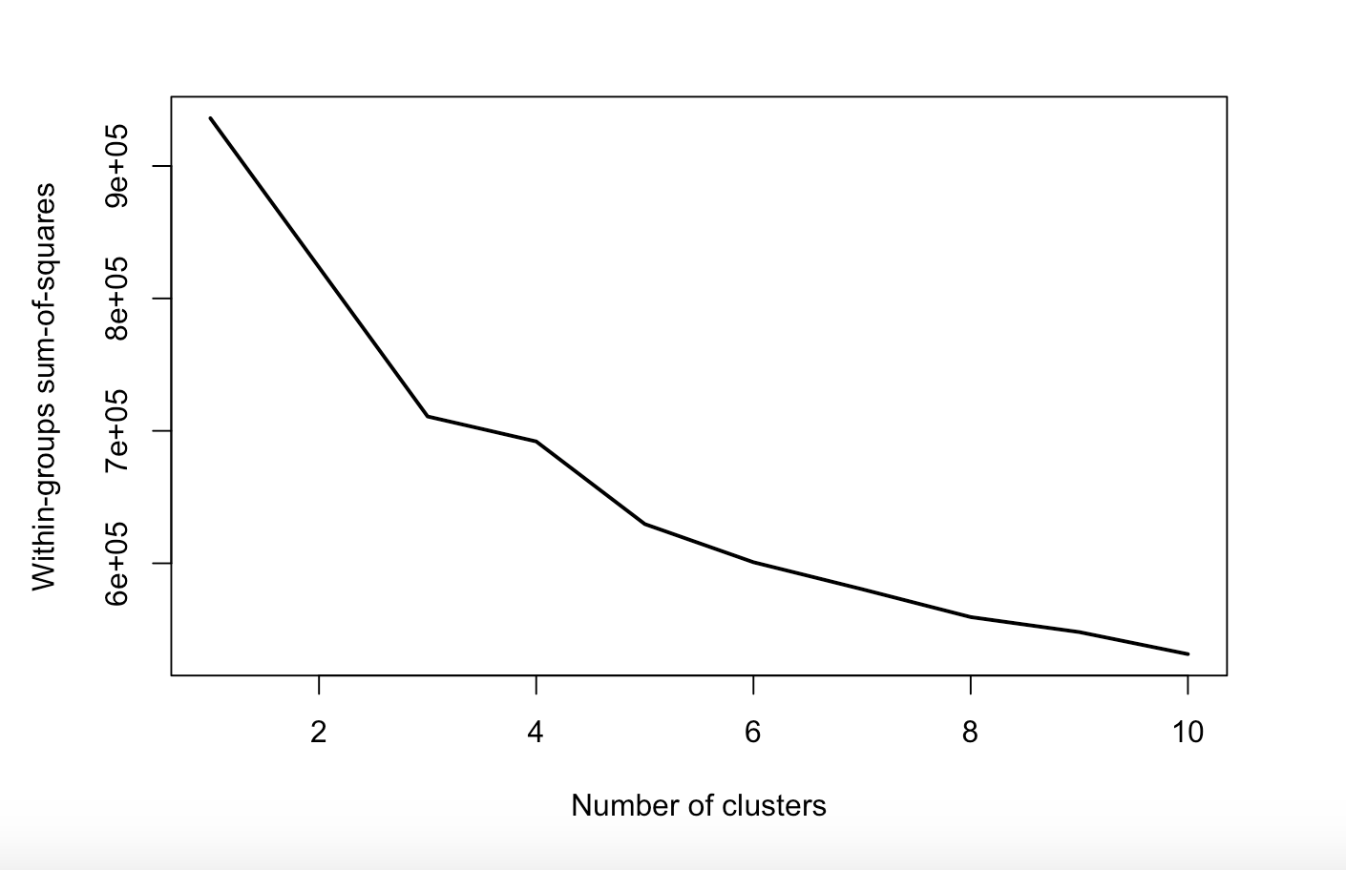

Clustering Analysis
Use Kmeans method to do clustering analysis on the 29 continuous variables that other team member has preprocessed before.
Try to find out if different levels of FHICOST(Cost of family medical/dental care in the past 12 months) will be in different clusters.
First test k ranging from 2 to 10 to find the best k to do the clustering analysis.
Notes:
So When a family is LESS likely to spend $500 or more in medical/dental cost per year?
When there is no working phone or cell phone in household
Lower the number of family member in Military or Medicaid
When a family rents house, apartment or is living with roommates
When a family member did not get medical advice or test in 2 weeks or stayed in hospital in 12 months,
When a family does not pay medical bills over the time
When family does not have flexible spending account

Slide 14
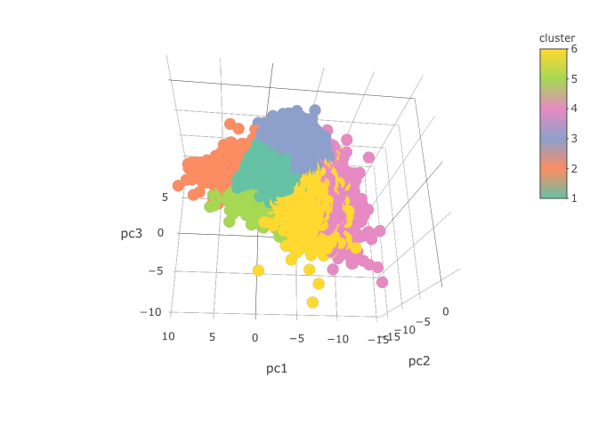
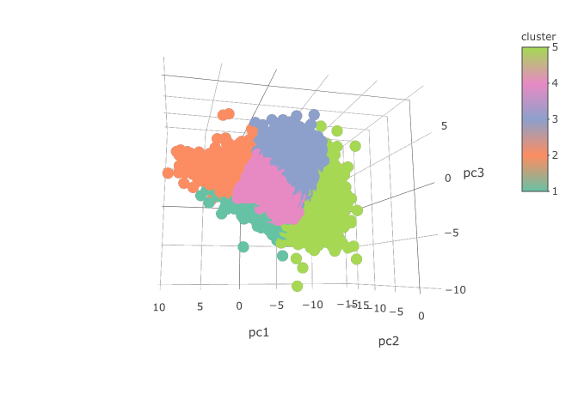
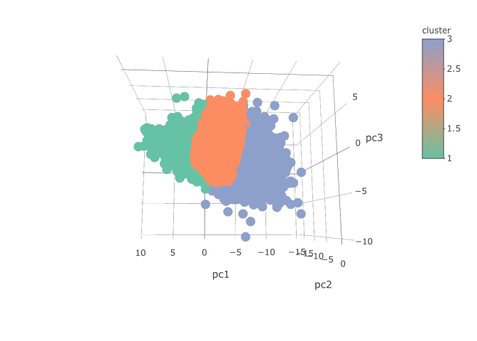
Clustering Analysis
Images from left to right are clustering results using k = 6, k = 5 and k = 3 plotted by three PCA components.
Notes:
Use Kmeans method to do clustering analysis on the 29 continuous variables that other team member has preprocessed before.
Try to find out if different levels of FHICOST(Cost of family medical/dental care in the past 12 months) will be in different clusters.
First test k ranging from 2 to 10 to find the best k to do the clustering analysis.
Images from left to right are clustering results using k = 6, k = 5 and k = 3 plotted by three PCA components.

Slide 15
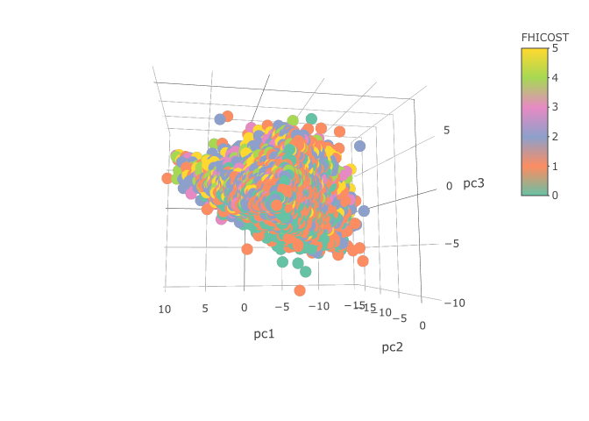
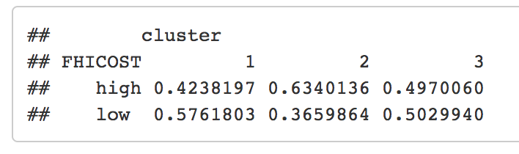
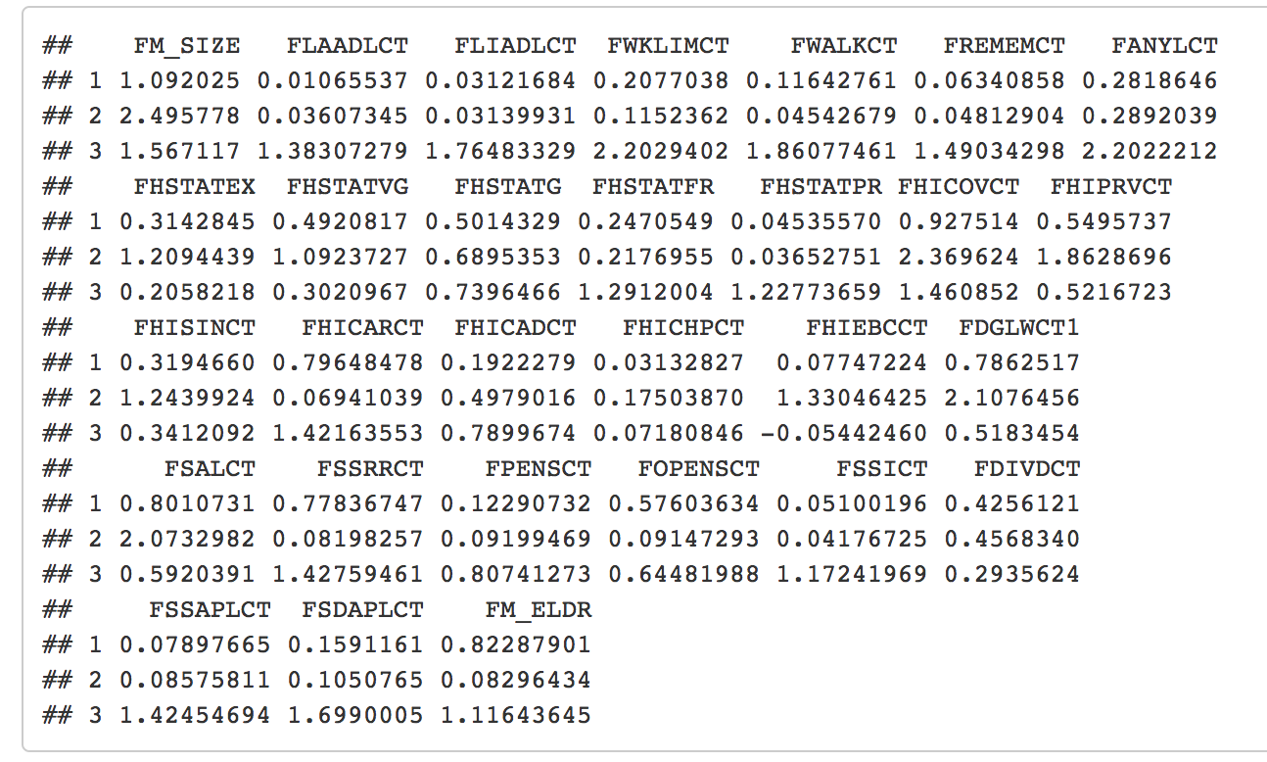
Clustering Analysis
Distribution of two levels of cost
Clusters using k =3
Plot by using three PCA components
Cluster center and the proportion of two levels of FHICOST in each cluster.
Notes:
If we look at the centers of three clusters by kmeans using k = 3 (referring to cluster-figure6). In the cluster2 that has highest percentage of high FHICOST, variable FHSTATEX(# fam mem in excellent health) and FHSTATVG(# fam mem in very good health) is higher then other clusters, which means families in this cluster are willing to pay more money to keep the family healthy. These families also have more members having health insurance coverage.
In cluster1 that has highest percentage of low FHICOST, it has much more family in poor health but there are more people not pay much in health care. In this cluster, there are more people receiving money from sources other than wages and salary. It has much higher FSSICT(# fam mem receive income from SSI (Supplemental Security Income)) and FSSRRCT(# fam mem receive income from Social Security or Railroad retirement inc),FSSAPLCT(# fam mem ever apply for SSI (Supplemental Security Income)), FSDAPLCT(# fam mem ever apply for SSDI (Social Security Disability)) which indicates they try to find other sources to help cover their healthcare cost. These families might have more difficulty living than other families which can also be found in higher FPENSCT(# fam mem receive disability pensions),lower FDGLWCT1(# of fam mem working last week) and higher FM_ELDR(# of family members over 65).

Slide 16
Correspondence Analysis
A multivariate technique used to explore relationships between categorical variables.
An ideal technique for our source data set, as over 50% of the variables were categorical.
Iterative process created to compare one categorical variable to another.
Summary of fit was reviewed to determine if there was correlation between the two variables in question.
Notes:
If we look at the centers of three clusters by kmeans using k = 3 (referring to cluster-figure6). In the cluster2 that has highest percentage of high FHICOST, variable FHSTATEX(# fam mem in excellent health) and FHSTATVG(# fam mem in very good health) is higher then other clusters, which means families in this cluster are willing to pay more money to keep the family healthy. These families also have more members having health insurance coverage.
In cluster1 that has highest percentage of low FHICOST, it has much more family in poor health but there are more people not pay much in health care. In this cluster, there are more people receiving money from sources other than wages and salary. It has much higher FSSICT(# fam mem receive income from SSI (Supplemental Security Income)) and FSSRRCT(# fam mem receive income from Social Security or Railroad retirement inc),FSSAPLCT(# fam mem ever apply for SSI (Supplemental Security Income)), FSDAPLCT(# fam mem ever apply for SSDI (Social Security Disability)) which indicates they try to find other sources to help cover their healthcare cost. These families might have more difficulty living than other families which can also be found in higher FPENSCT(# fam mem receive disability pensions),lower FDGLWCT1(# of fam mem working last week) and higher FM_ELDR(# of family members over 65).

Slide 17
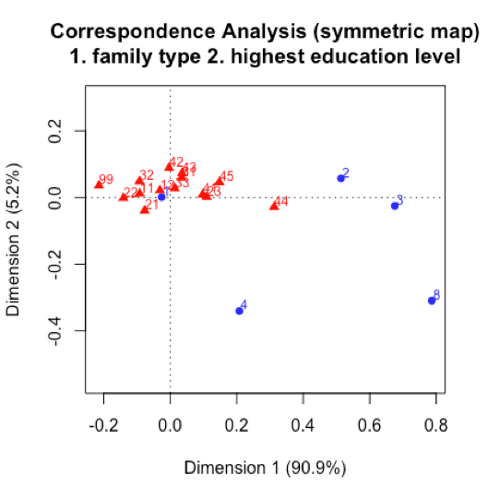
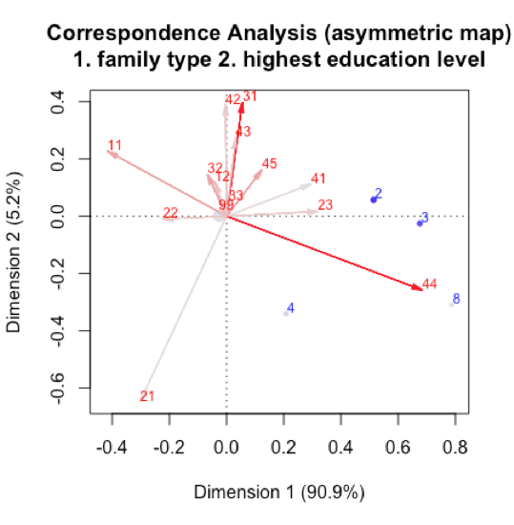
Correspondence Analysis
Principal inertias (eigenvalues):
dim value % cum% scree plot
1 0.014571 90.9 90.9 ***********************
2 0.000828 5.2 96.1 *
3 0.000575 3.6 99.6 *
4 5.7e-050 0.4 100.0
-------- -----
Total: 0.016031 100.0
Notes:
If we look at the centers of three clusters by kmeans using k = 3 (referring to cluster-figure6). In the cluster2 that has highest percentage of high FHICOST, variable FHSTATEX(# fam mem in excellent health) and FHSTATVG(# fam mem in very good health) is higher then other clusters, which means families in this cluster are willing to pay more money to keep the family healthy. These families also have more members having health insurance coverage.
In cluster1 that has highest percentage of low FHICOST, it has much more family in poor health but there are more people not pay much in health care. In this cluster, there are more people receiving money from sources other than wages and salary. It has much higher FSSICT(# fam mem receive income from SSI (Supplemental Security Income)) and FSSRRCT(# fam mem receive income from Social Security or Railroad retirement inc),FSSAPLCT(# fam mem ever apply for SSI (Supplemental Security Income)), FSDAPLCT(# fam mem ever apply for SSDI (Social Security Disability)) which indicates they try to find other sources to help cover their healthcare cost. These families might have more difficulty living than other families which can also be found in higher FPENSCT(# fam mem receive disability pensions),lower FDGLWCT1(# of fam mem working last week) and higher FM_ELDR(# of family members over 65).

Slide 18
Linear Discriminant Analysis
A classification method that is simple to understand, yet mathematically robust.
The technique searches for a linear combination of variables that best separate the target variable into classes.
Ideal and applicable to the project because the target variable is categorical.
Multiple iterations of LDA were produced:
With PCA: 21%
With PCA inputs: 22%
With dummy variables: 72%
Notes:
If we look at the centers of three clusters by kmeans using k = 3 (referring to cluster-figure6). In the cluster2 that has highest percentage of high FHICOST, variable FHSTATEX(# fam mem in excellent health) and FHSTATVG(# fam mem in very good health) is higher then other clusters, which means families in this cluster are willing to pay more money to keep the family healthy. These families also have more members having health insurance coverage.
In cluster1 that has highest percentage of low FHICOST, it has much more family in poor health but there are more people not pay much in health care. In this cluster, there are more people receiving money from sources other than wages and salary. It has much higher FSSICT(# fam mem receive income from SSI (Supplemental Security Income)) and FSSRRCT(# fam mem receive income from Social Security or Railroad retirement inc),FSSAPLCT(# fam mem ever apply for SSI (Supplemental Security Income)), FSDAPLCT(# fam mem ever apply for SSDI (Social Security Disability)) which indicates they try to find other sources to help cover their healthcare cost. These families might have more difficulty living than other families which can also be found in higher FPENSCT(# fam mem receive disability pensions),lower FDGLWCT1(# of fam mem working last week) and higher FM_ELDR(# of family members over 65).

Slide 19
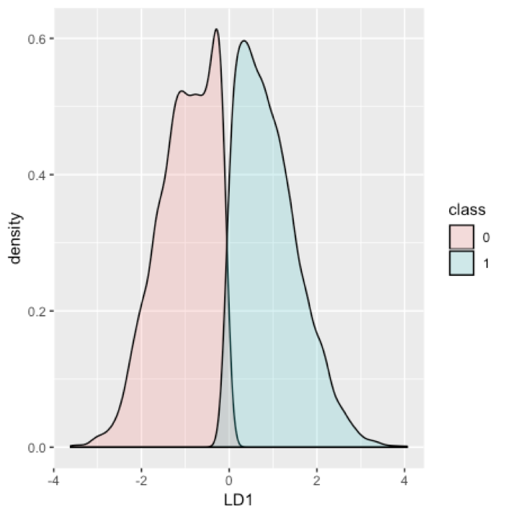
Linear Discriminant Analysis
Notes:
If we look at the centers of three clusters by kmeans using k = 3 (referring to cluster-figure6). In the cluster2 that has highest percentage of high FHICOST, variable FHSTATEX(# fam mem in excellent health) and FHSTATVG(# fam mem in very good health) is higher then other clusters, which means families in this cluster are willing to pay more money to keep the family healthy. These families also have more members having health insurance coverage.
In cluster1 that has highest percentage of low FHICOST, it has much more family in poor health but there are more people not pay much in health care. In this cluster, there are more people receiving money from sources other than wages and salary. It has much higher FSSICT(# fam mem receive income from SSI (Supplemental Security Income)) and FSSRRCT(# fam mem receive income from Social Security or Railroad retirement inc),FSSAPLCT(# fam mem ever apply for SSI (Supplemental Security Income)), FSDAPLCT(# fam mem ever apply for SSDI (Social Security Disability)) which indicates they try to find other sources to help cover their healthcare cost. These families might have more difficulty living than other families which can also be found in higher FPENSCT(# fam mem receive disability pensions),lower FDGLWCT1(# of fam mem working last week) and higher FM_ELDR(# of family members over 65).

Slide 20
Conclusion
Principal Component Analysis: 12 Main Components 28 Variables explaining 79% variance.
Common Factor Analysis : 3 Main Factors for 22 Variables explaining 50% of variance.
Logistic Regression : Families with lower socioeconomic status pay less than $500 per year for medical/dental expenses
Clustering Analysis : People with better health tend to pay more for insurance for that health outcome
Correspondence Analysis : Family type and relationship to highest education level
Linear Discriminant Analysis : The cost of healthcare could be predicted based upon 72% accuracy above or below a certain threshold
Notes:
Reviewed other 26 variables did not see much correlation

